Slide 1
Joining & Merging Data
Jeremy Bergmann - Omaha Data Science Academy

Slide 2
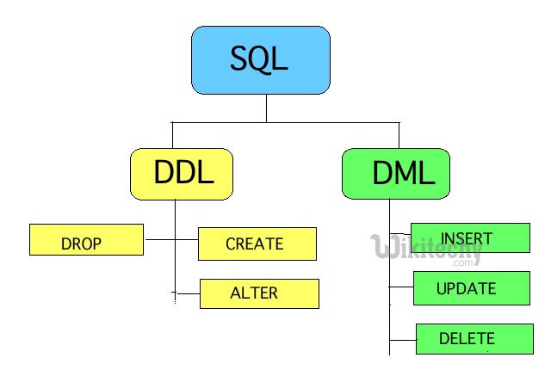
Class 3 Review – Data Storage
Data Storage
Create and delete databases
Create and delete tables
Create tables with constraints
Add and delete table fields
Add and delete table constraints
Insert data into tables (Manual,Code)
Import data from SQL and CSV files
Notes:
Feynman technique: Learn -> Explain -> Reflect -> Repeat
What are the most important ideas from last class? Write a summary of the information as if explaining to a 14 year old. Avoid jargon Keep the words and sentences simple Rely on memory Make the explanation visual, if possible Note where you had difficulty or have knowledge gaps. These indicate things you should review, research, or ask questions about

Slide 3
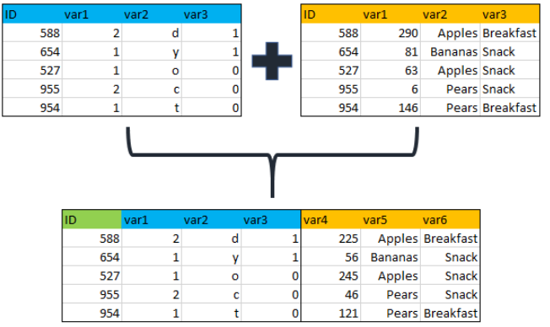
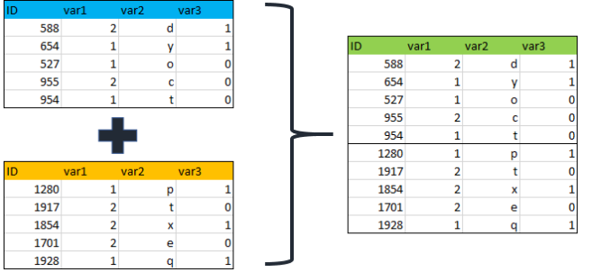
Class 4 Objectives
Joining & Merging Data
Joining Data - inner, outer and left Merging/Appending Data – Union/Union All
Notes:
Feynman technique: Learn -> Explain -> Reflect -> Repeat
What are the most important ideas from last class? Write a summary of the information as if explaining to a 14 year old. Avoid jargon Keep the words and sentences simple Rely on memory Make the explanation visual, if possible Note where you had difficulty or have knowledge gaps. These indicate things you should review, research, or ask questions about

Slide 4
What is the need for data manipulation?
Creating new datasets & Combine disparate data sets
Perform common queries, aggregations, and joins
Adding, removing, or modifying data
Extracting and Storing Data
Creation/Extraction
Transforming data
Cleaning data
Storage & Retrieval
Notes:
Creation: creating tables and databases, the things
Storage: where data are stored
Cleaning: adding, removing, or modifying data
Retrieval: selecting only the data you want

Slide 5
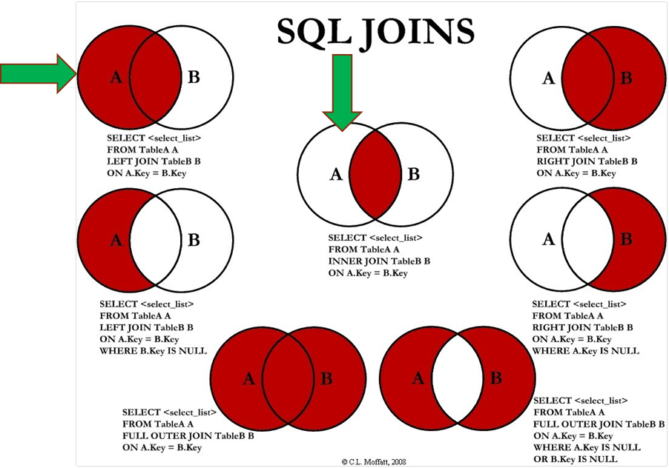
How do you combine data?
Answer:
SQL Joins can be done using WHERE or JOIN clauses!
Notes:
Most Common - INNER & LEFT, Sometimes Full Outer

Slide 6
Inner Join
Syntax SELECT <columns> FROM <table> AS <alias> INNER JOIN <table> AS <alias2>
ON <alias>.<table column>
= <alias2>.<column>
Source: https://datapractices.org/courseware/2_7.html

Slide 7
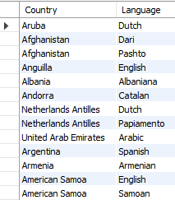
Inner Join - Example
Example - Official Languages SELECT a.`name` AS country, b.`language` FROM world.country as a INNER JOIN world.countrylanguage AS b ON a.code = b.countrycode and b.isofficial ='T'
Notes:
SELECT a.`name` AS country, b.`language`
FROM world.country as a
INNER JOIN world.countrylanguage AS b
ON a.code = b.countrycode and b.isofficial ='T'

Slide 8
Left Join
Syntax SELECT <columns> FROM <table> AS <alias> LEFT JOIN <table> AS <alias2>
ON <alias>.<table column>
= <alias2>.<column>
Source: https://datapractices.org/courseware/2_7.html
Notes:
SELECT a.`name` AS country, b.`language`
FROM world.country as a
INNER JOIN world.countrylanguage AS b
ON a.code = b.countrycode and b.isofficial ='T'

Slide 9
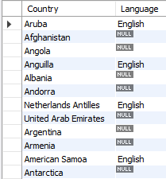
Left Join - Example
Question: “Which countries do/do not speak English as a language?”
Example
SELECT a.`name` AS country, b.`language` FROM world.country AS a LEFT JOIN world.countrylanguage AS b ON a.code = b.countryCode AND b.`Language` ='English'
Notes:
SELECT a.`name` AS country, b.`language`
FROM world.country AS a
LEFT JOIN world.countrylanguage AS b
ON a.code = b.countryCode AND b.`Language` ='English'

Slide 10
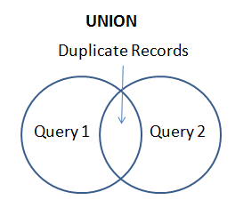
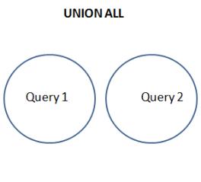
SQL Union & Union All
Purpose: The UNION operator is used to append the result-set of two or more SELECT statements.
Each SELECT statement within UNION must have the same number of columns
The columns must also have similar data types
The columns in each SELECT statement must also be in the same order

Slide 11
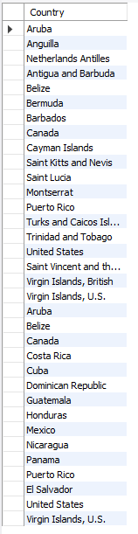
SQL Union All
Example
SELECT a.`name` as country
FROM world.country as a
INNER JOIN world.countrylanguage as b
ON a.`code` = b.countrycode AND b.`Language`='English’
WHERE a.Continent = 'North America’
UNION ALL
SELECT a.`name` as country
FROM world.country AS a
INNER JOIN world.countrylanguage AS b
ON a.`code` = b.countrycode AND b.`Language`='Spanish’
WHERE a.continent = 'North America'
Question: “List all countries in North America that speak English or Spanish as a language, with duplication.
/
Notes:
SELECT a.`name` AS country
FROM world.country AS a
INNER JOIN world.countrylanguage AS b
ON a.`code` = b.countrycode AND b.`Language`='English’’
WHERE a.Continent = 'North America’
UNION ALL
SELECT a.`name` AS country
FROM world.country AS a
INNER JOIN world.countrylanguage AS b
ON a.`code` = b.countrycode AND b.`Language`='Spanish’
WHERE a.continent = 'North America’

Slide 12
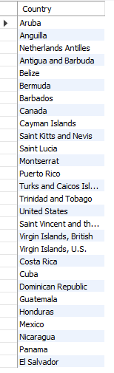
SQL Union
Example
SELECT a.`name` AS country
FROM world.country AS a
INNER JOIN world.countrylanguage as b
ON a.`code` = b.countrycode AND b.`Language`='English’
WHERE a.Continent = 'North America’
UNION
SELECT a.`name` as country
FROM world.country AS a
INNER JOIN world.countrylanguage AS b
ON a.`code` = b.countrycode AND b.`language`= 'spanish'
WHERE a.continent = 'North America'
Question:
“List all countries in North America that speak English or Spanish as a language, with no duplication.
Notes:
SELECT a.`name` AS country
FROM world.country AS a
INNER JOIN world.countrylanguage AS b
ON a.`code` = b.countrycode AND b.`Language`='English'
WHERE a.Continent = 'North America’
UNION
SELECT a.`name` as country
FROM world.country AS a
INNER JOIN world.countrylanguage AS b
ON a.`code` = b.countrycode AND b.`Language`='Spanish’
WHERE a.continent = 'North America'

Slide 13
Full Outer Join
Syntax SELECT <columns> FROM <table> AS <alias> FULL OUTER JOIN <table> AS <alias2>
ON <alias>.<table column>
= <alias2>.<column>
Source: https://datapractices.org/courseware/2_7.html

Slide 14
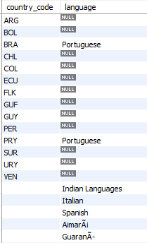
Full Outer Join - Example
Question: “List the names for all South American countries that speak/don’t speak Portugese, while including all other spoken languages”
MySQL Example
SELECT a.`code` AS country_code, b.`language`
FROM world.country AS a
LEFT JOIN world.countrylanguage AS b
ON a.`code`=b.countrycode AND b.`language`='Portuguese’
WHERE a.continent = 'South America’
UNION
SELECT ‘’ AS country_code, b.`language`
FROM world.country AS a
RIGHT JOIN world.countrylanguage AS b ON a.`code`=b.countrycode
WHERE a.continent = 'South America'
Notes:
SELECT a.`code` AS country_code, b.`language`
FROM world.country AS a
LEFT JOIN world.countrylanguage AS b
ON a.`code`=b.countrycode and b.`language` = 'Portuguese’
WHERE a.continent = 'South America’
UNION
SELECT ‘’ AS country_code, b.`language` FROM world.country AS a
RIGHT JOIN world.countrylanguage AS b ON a.`code`=b.countrycode
WHERE a.continent = 'South America'

Slide 15
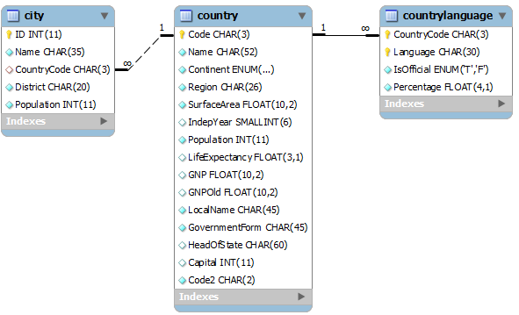
Exercises
SQL Joins & Unions
1. Using a union on the world.country table, combine all countries (repeating) with a life expectancy of > 80 years or a GNP > 1000000, with no repeats.
2. List all official languages spoken in the 'Southeast Asia' region.
3. List all the countries in North America, then match (left join) the “percentage” of the population that speaks English.
4. In the “world” schema, obtain the name of all cities in North America that have a population over 1M, where the primary language is English or Spanish (with repeats).
Notes:
Schema: https://gist.github.com/mdang/9a4a8063ebea3b829b8025746643ade1

